Slide 1
UML Class Notation
Class
Visibility
Student
+ name: string # id: int - section: string
+ Display(name: string): void - Add(): void - Edit(): void # Delete(): void
Name
Public (+)
Protected (#)
Private (-)
Attributes (Fields/Properties)
Operations (Methods)

Slide 2
Class Diagram
UML Class Diagram Relationships
Inheritance
Association
Aggregation
Composition
Multiplicity

Slide 3
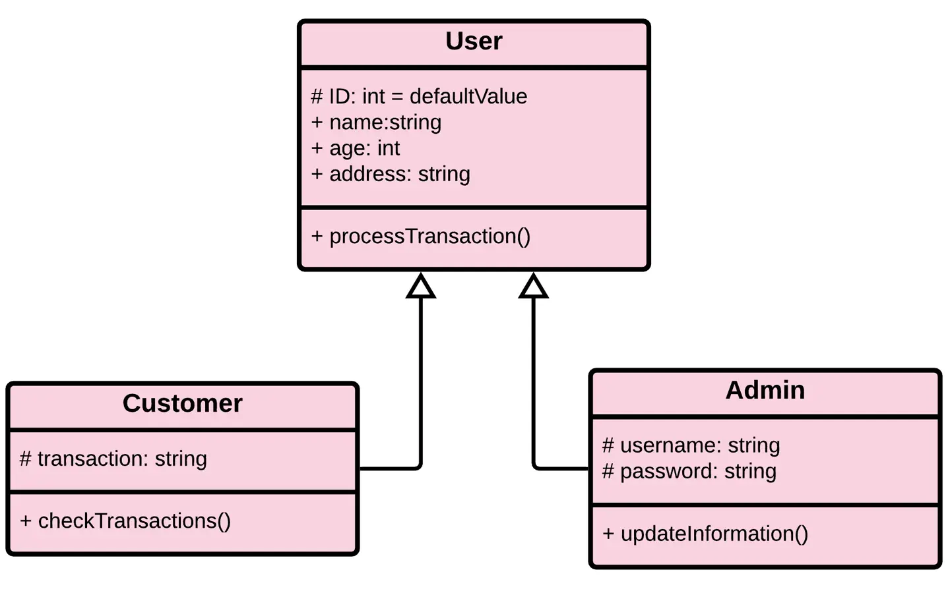
Class Diagram Relationship - Inheritance
Is-A

Slide 4
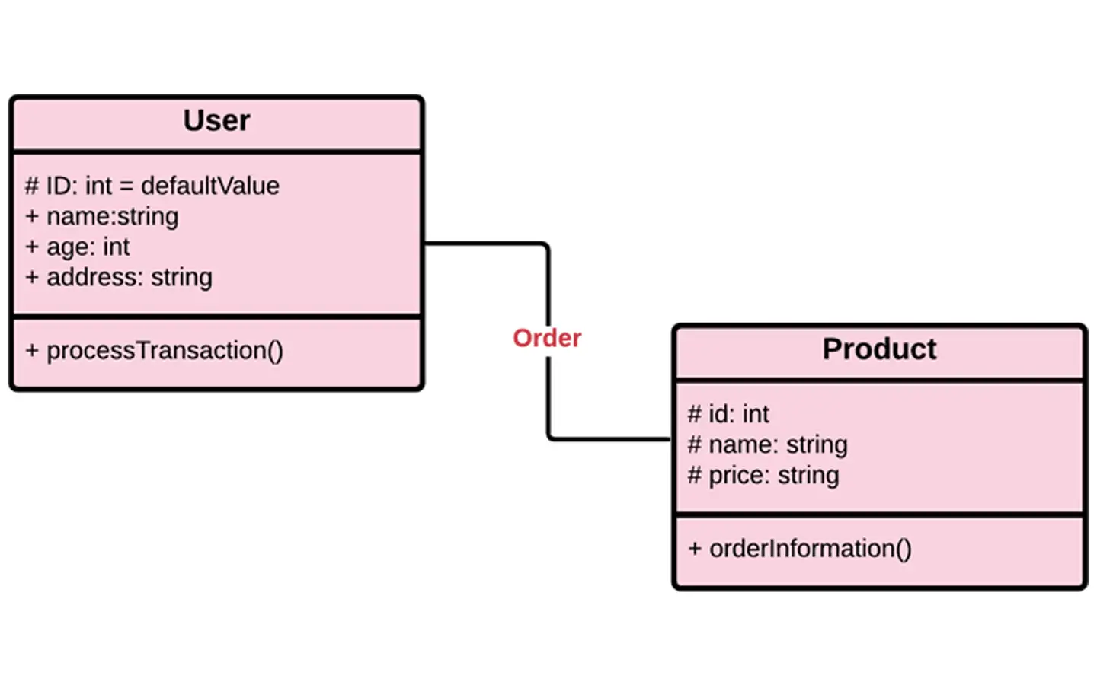
Class Diagram Relationship - Association
This illustrates that there is association between classes but there’s no dependency.

Slide 5
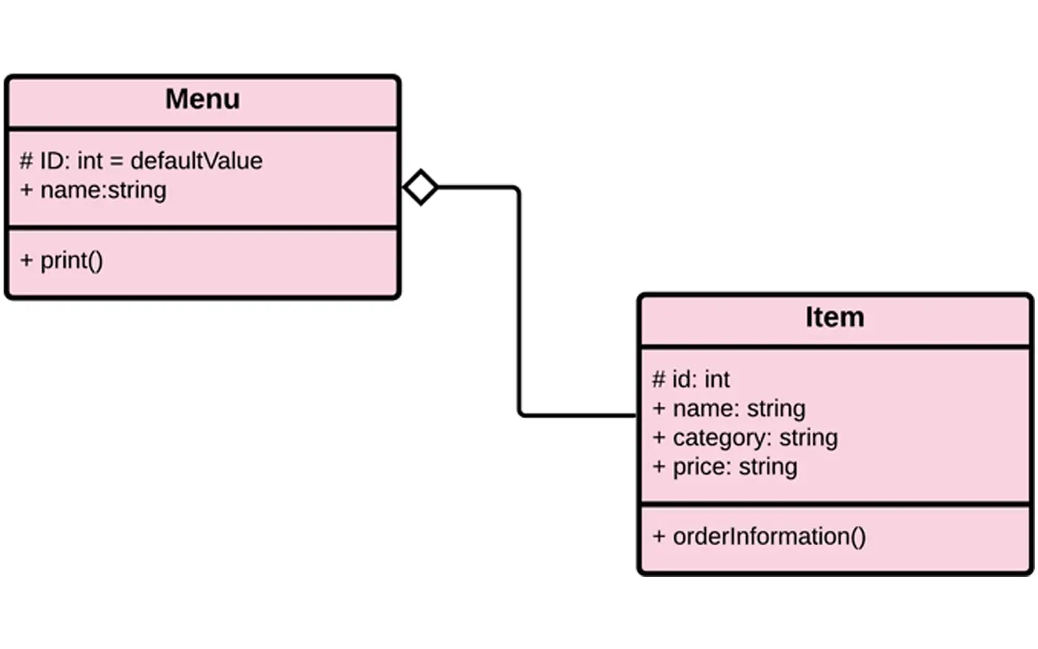
Class Diagram Relationship - Aggregation
Aggregation conveys that a class or a subclass can exist outside a whole.

Slide 6
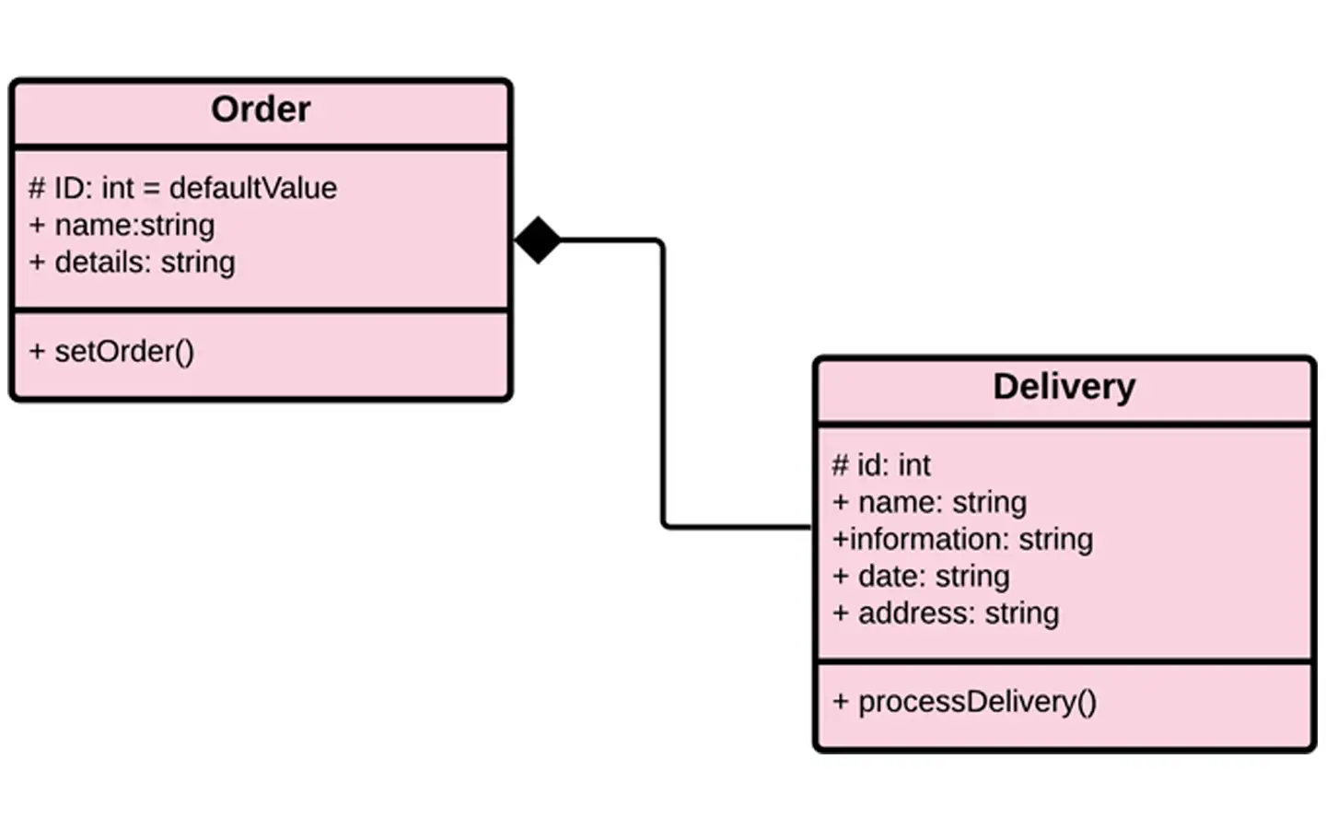
Class Diagram Relationship - Composition
Composition conveys that a class or a subclass can not exist outside a whole. Because, every class or subclasses is composed of another class.

Slide 7
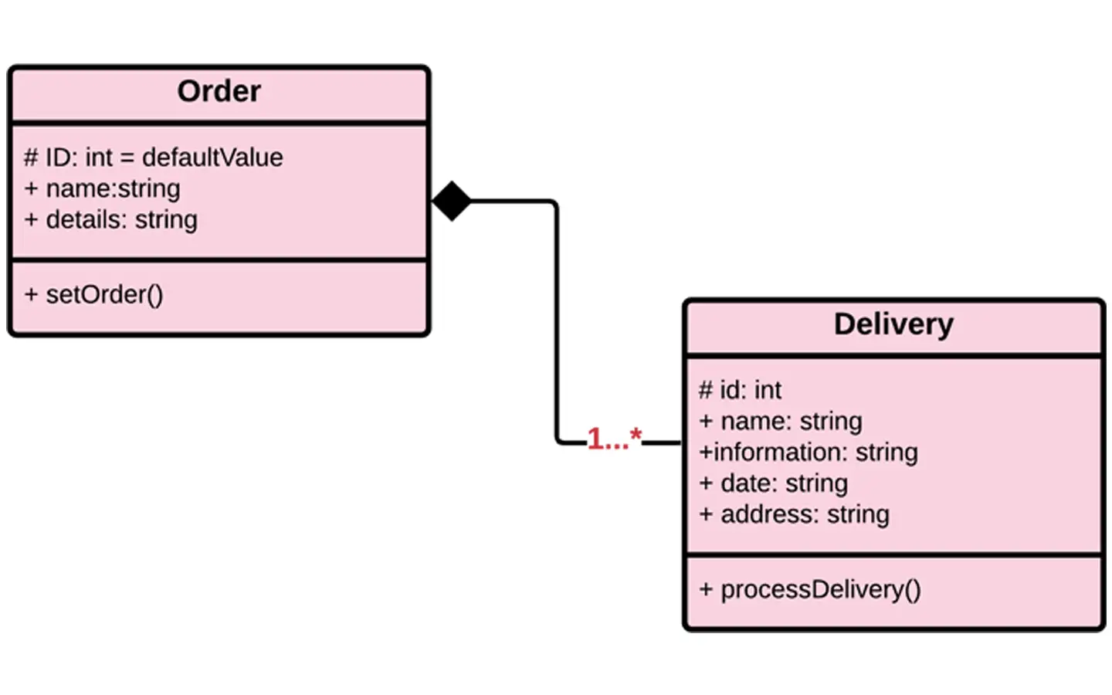
Class Diagram Relationship - Multiplicity
This allows you to set numerical constraints on the Class Diagram

Slide 8
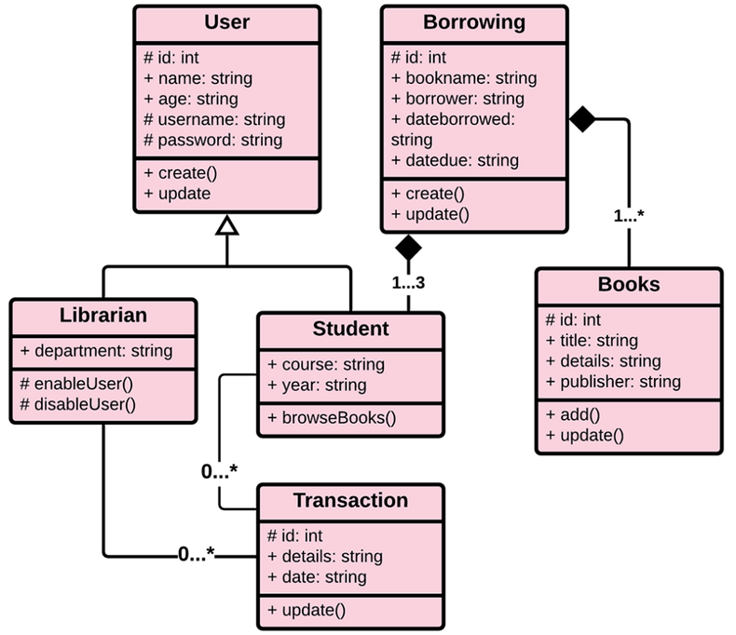
Class Diagram – Library Management Sys.

Slide 9
Use Case Diagram
The use case diagram represents the interactions between the actors (Librarian, Member) and the system.

Slide 10
Use Case Diagram – Library Management Sys.
Actors
Use Cases
System Boundary
General Use Case
Manage Books
Manage Members
Librarian
Borrow Books
Member
Return Books
Records of Members Transactions

Slide 11
Use Case Diagram – Library Management Sys.
Manage Members
Checks and Saves New Information
Manage Members
<<include>>
<<include>>
Librarian
Member’s New Information
<<extend>>
Update Member’s Status
<<include>>: Represents a mandatory behavior or functionality that is always included in the execution of the base use case.
<<extend>>: Represents an optional or conditional behavior that extends the base use case only under certain circumstances.

Slide 12
Use Case Diagram – Library Management Sys.
Manage Members
Checks and Saves New Information
Manage Books
<<include>>
<<include>>
Librarian
Book’s New Information
<<extend>>
Update Book’s Status

